Slide 1
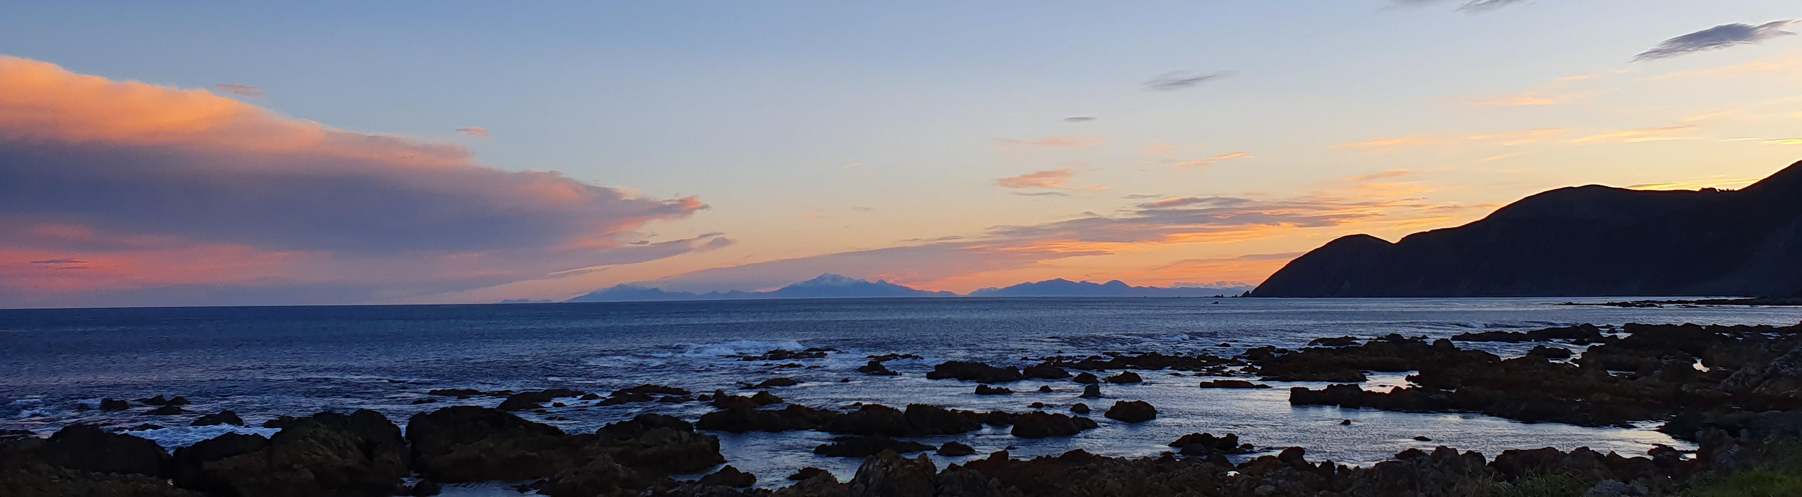
Annual General Meeting
2023 Ōwhiro Bay Residents’ Association

Slide 2
Agenda
1. Welcome
2. Apologies
3. Confirmation of minutes 2022 Annual General Meeting
4. Finance Report
5. Annual Report
6. Election of officers
7. General Business

Slide 3
Minutes of 2022 AGM
Meeting was online
Outstanding items from those minutes
Speed limit on Ōwhiro Bay Parade
Weeds on The Green
Community wanting Information on the release of kiwi in the hills

Slide 4
Finance Report
Statement of Financial Position
 | Jun-2021 | Jun-2022 | Jun-2023
Current Assets
ANZ Cheque Account | 1,851.67 | 2,587.85 | 4,331.41
Cash on Hand | - | 315
Total Assets | 1,851.67 | 2,902.85 | 4,331.41
Liabilities
Baptist Church |  |  | -100.00
Reimbursed expenses |  |  | -385.00
Total Liabilities | 157.68 | Nil | -485.00
Net Financial Position |  |  | $3,846.41
Balance at start of year |  | $1,693.99 | $2,902.85
Balance end of year | $1,693.99 | $2,902.85 | $3,846.41
Change in Financial Position |  | $1,208.86 | $943.56
Statement of Financial Performance for year
Income | Jun-2021 | Jun-2022 | Jun -2023
WCC funding | 1,550.00 | 1,000.00 | 1,000.00
Consultation Income |  |  | 600.00
Interest | 0.08 | 0.62 | 51.93
Matariki Event |  | 415.00
Total | $1,550.08 | $1,415.62 | 1,651.93
Expenditure
Function expenses | 157.68 | 161.76 | -492.50
Internet |  | 45.00 | -192.50
 |  |  | -23.37
Total | $157.68 | $206.76 | -708.37
Surplus for the year | $1,392.40 | $1,208.86 | $943.56

Slide 5
Annual Report
2023 Ōwhiro Bay Residents’ Association

Slide 6
Report to the AGM
Committee
Sue Reid – Chair
Rachel Steele – Secretary
Ian Reid – Treasurer
Alison Forrest – Landfill Subcommittee co-lead
Angela Wilson – Landfill Subcommittee co-lead
Mo Blishen – Events Subcommittee
Chris Loveday – Events Subcommittee
Eugene Doyle – Environment Subcommittee
Matt Beaulieu – Environment Subcommittee
Hannah Quigan – Committee
Resignation of former President Catherine Skinner in February 2023

Slide 7
Events
Matariki
Meet the candidates
Community survey
Emergency Community Hub Day
Easter Hunt
Cirque d’O Bay
MidWinter Dip
Support for 4C event – May

Slide 8
Landfill
Participating in the Council-run Working Group for the Landfill Piggyback extension.
February – Oral submission to the Environment and Infrastructure Committee on the Landfill Extension Business case.
February – Written and Oral Submission on WCC’s Waste Strategy
April – Written and Oral Submisions on their draft Zero Waste Strategy
September – Written and Oral Submissions on the Waste Management and Minimisation Plan

Slide 9
Advocacy and submissions
Submission on the Open Space and Recreation Strategy
Beach grading

Slide 10
Environment
Nearly 500 plants in the ground in August 2023.
OBRA support for the works and planting at Happy Valley Park carpark
Trapping and penguin nest box monitoring continues
Water Quality Ōwhiro Stream

Slide 11
Community Engagement and Resilience
OBRA part of the Ōwhiro Catchment Collective
OBRA represented in the 4C Community
Hui on 5 August 2023 to set out a vision/community framework for the catchment.
Community Hub – Meeting 29 October at the School to establish a hub.
Public transport/Bus Service to Ōwhiro Bay

Slide 12
Wasters of Ōwhiro Bay
Development of list of recycling places – ongoing. Lead by Mina.
Pursuing of community food swap location.

Slide 13
Election of Officers
President: Sue Reid
Secretary: Rachel Steele
Treasurer: Ian Reid
Committee: Ali Forrest, Eugene Doyle, Mo Blishem, Chris Loveday, Angela Wilson, Hannah Quigan.
Welcome to new members Cheryl Smith and Anna Mareia Hammond

Slide 14
General Business
Acknowledge the contribution of former OBRA president Catherine Skinner who stood down from the Committee in February 2023.
Acknowledge too Matt Beaulieu who stood down at this year’s AGM.

Slide 15
Thank you
Councillors Foon and Abduraham
Ōwhiro Bay School
Ōwhiro Bay community
OBRA committee

